Slide 1
CS294: Deep Learning Frameworks
Joey Gonzalez and Ion Stoica
February 4, 2019

Slide 2

History: single machine
2007: Sci-kit learn:
Public release: 2010
Machine learning (ML) library for Python
Large number of “classic” ML algorithms, e.g.,
Linear and logistic regression, SVM, random forests, k-means, gradient-boosting
Highly successful to this day

Slide 3
History: big data ML
Lots of more data available, so people developed distributed algorithms:
Still “classic” ML, e.g., logistic regression, collaborative filtering
2009: Mahout: ML library on top of Apache Hadoop
Slow. Each iteration reads/writes data on disk
2011: MLlib: ML library for Apache Spark
Developed at AMPLab, Berkeley
Much faster than Mahout: no reads/writes to the disk
Still the library of choice for distributed “classic” ML algorithms

Slide 4
Neural Networks: Single machine libraries
2007: Theano
Developed by Montreal Institute for Learning Algorithms (MILA)
Initially no support for GPUs
Why support for GPU important?
NN requires basically matrix multiplication
Space complexity: O(N²)
Computation complexity: O(N³)
Thus, computation complexity super-linear in the input

Slide 5
Neural Networks: Single machine libraries
2007: Theano
Developed by Montreal Institute for Learning Algorithms (MILA)
Initially no support for GPUs
2014: Caffee
Developed by Berkeley Vision and Learning Center
Support for GPUs, some popular neural networks, e.g., AlexNet
2016: PyTorch
Developed by Facebook
Loosely based on Torch (started in 2002, but no longer sctive)
Initially single machine, recently distributed

Slide 6
Neural Networks: Distributed systems
2015: Tensorflow
Developed by Google Brain
The most popular ML library today
2015: MXNet
Initially, by UW and others; now by AWS
Systems for data-parallel training leveraging single-machine Tensorflow and PyTorch
Horovod, RLlib (Ray), …

Slide 7
Computation model
Dataflow graph, e.g.,
MLlib (Spark), Tensorflow, MXNet, PyTorch
Evaluation:
Lazy: MLlib (Spark), MXNet, Tensorflow (originally)
Enable better optimizations
Eager: PyTorch
Easier to debug
Data:
Immutable (e.g., Mllib): easy provide fault tolerance
Mutable (e.g., Tensorflow, MXNet) : more efficient

Slide 8
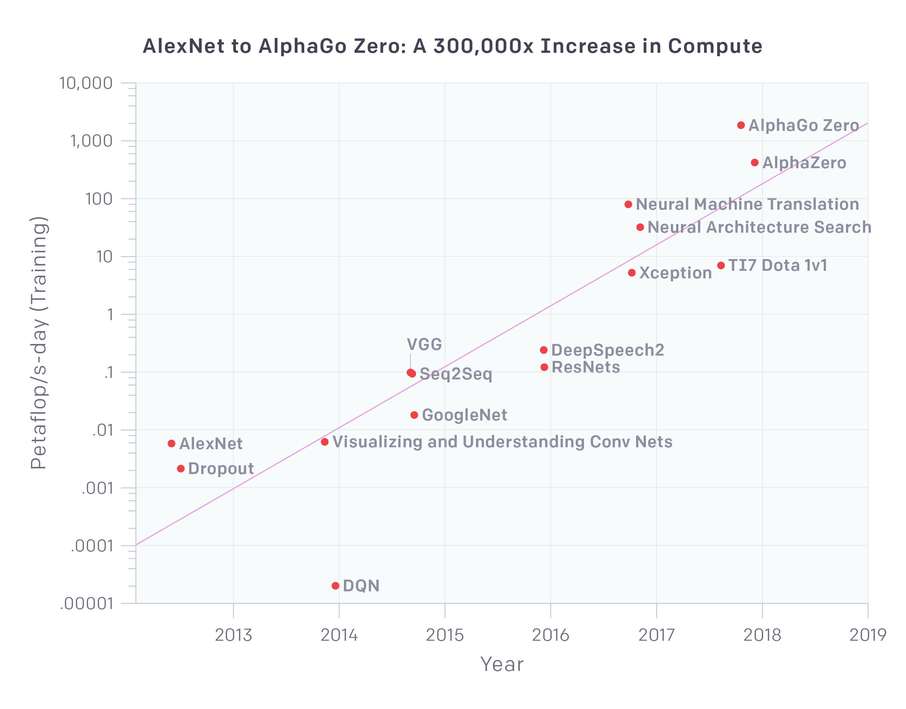
Compute system requirements
Compute requirements doubling every 3 months!
AI and Compute (https://blog.openai.com/ai-and-compute/)

Slide 9
Moore’s law is dead
Communication of the ACM (https://myacm.acm.org/dashboard.cfm?svc=cacmde&ref=mags)

Slide 10
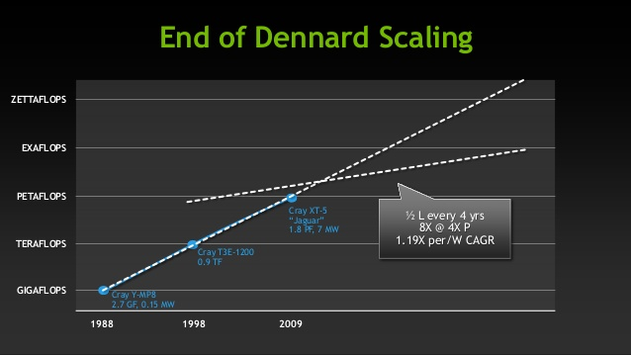
Dennard scaling
As transistors get smaller, their power density stays constant
Performance & memory capacity per-watt increase exponentially

Slide 11
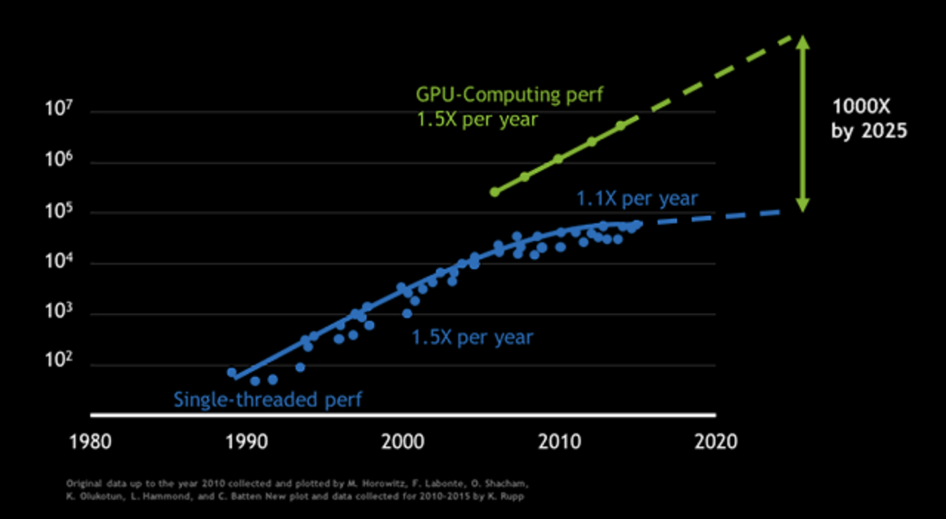
In the meantime…
GPU performance increase still follows Moore’s law
A plethora of NN accelerators are being developed (e.g. TPU)

Slide 12
So, what does it mean?
The computation requirements growing much faster than Moore’s law
FLOPs still continue to double every 18 months
GPUs and hardware accelerators
However, RAM capacity growing very slowly
Next generation of ML systems
Distributed
Efficiently use specialized, heterogeneous hardware

Slide 13
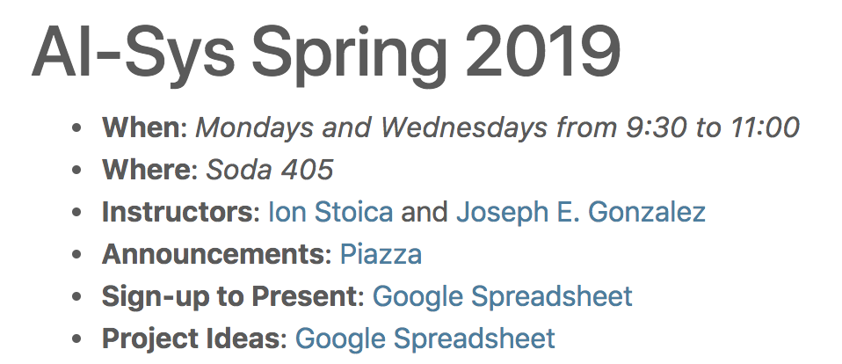
Projects
By Wednesday 2/6:
Check current list of projects: https://tinyurl.com/ycbqz22q
Add your own project

Slide 14
Projects
By Wednesday 2/6:
Check current list of projects: https://tinyurl.com/ycbqz22q
Add your own project
By Friday 2/8:
Specify your project preference
By Monday 2/11:
Project matching: at least two, and at most three people per project.

